Slide 1


POLYTRONICS
By
Student Name : Navneet Nipu Roll No: ECE#201710518
BPUT Regn. No:1701202158
Under the guidance of
Prof. Santosh Kumar Patnaik
Notes:
B-TECH PROJECT MID-SEM PRESENTATION 2011
BY KHUSHBU KHAN & ISAN SAHOO

Slide 2
CONTENTS
WHAT IS POLYMER ELECTRONICS?
WHAT MAKES POLYMER SO SUITABLE FOR ELECTRONICS APPLICATION?
ELECTRIC CONDUCTOR POLYMER TYPES
INTRINSICALLY CONDUCTIVE POLYMER
TWO CONDITIONS TO BECOME CONDUCTIVE
ICP MATERIAL
PROPERTIES OF ICP
ICP AS A MATRIX POLYMER
ELECTRICAL PROPERTIES OF ICP BASED NANOCOMPOSITES
APPLICATION
PRINTED ELECTRONICS
PRINTED ELECTRONICS METHODS
STRUCTURE OF OTFT
APPLICATION OF ORGANIC TFT
ADVANTAGES V/S DISADVANTAGES OF POLYMER ELECTRONICS
CONCLUSION
Reference

Slide 3
WHAT IS POLYMER ELECTRONICS?
Polymers are long-chain molecules consisting of many repeat units to make a solid material.
Polymers are normally electrical insulators, but to enable their use in electronics, conductive filler such as silver have been added to chemical formulation to increase their electrical conductivity.
The merits in this research area, the Nobel Prize 2000 for Chemistry was awarded to Alan J. Heeger, Alan G. MacDiarmid und Hideki Shirakawa.

Slide 4
WHAT MAKES POLYMER SO SUITABLE FOR ELECTRONICS APPLICATION?
Good insulator of heat
Can form any shape.
They have low density
They require low finishing cost.
Their toughness and ductility is good.
Enhanced flexibility allowed for many application.Solubility in organic solvents, variable processibility.

Slide 5
ELECTRIC CONDUCTOR POLYMER TYPES
Depending on the type of charge transport by the carriers responsible for it
Ionically conductive polymer:
It is used as a solid-state electrolyte in batteries.
Eg: poly ethylene oxide which contain lithium perchlorate(LiClO4).
Electronically conductive:
Filled conductive polymers
Intrinsically conductive polymers

Slide 6
INTRINSICALLY CONDUCTIVE POLYMER
They do not incorporate any conductive additives.
They gain their electrical Conductivity through a property known as ‘conjugation’.
Conjugated polymers are doped with atoms that donate negative or positive charges enabling current to travel down the polymer chain.

Slide 7

TWO CONDITIONS TO BECOME CONDUCTIVE
The first condition is the polymer consists of alternating single and double bonds, called conjugated double bonds.
In conjugation, the bonds between the carbon atoms are alternately single and double. Every bond contains a localised “sigma” (σ) bond which forms a strong chemical bond. In addition, every double bond also contains a less strongly localised “pi” (π) bond which is weaker.

Slide 8
Contd…
The second condition is the plastic has to be disturbed - either by removing electrons from (oxidation), or inserting them into (reduction), the material. The process is known as Doping.
There are two types of doping:
Oxidation with halogen (or p-doping).
Reduction with alkali metal (called n-doping).

Slide 9
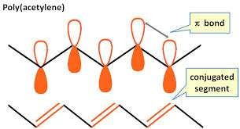
ICP MATERIAL
Polyaniline
Polythiophene
Polypyrrole
Polyacetylene

Slide 10
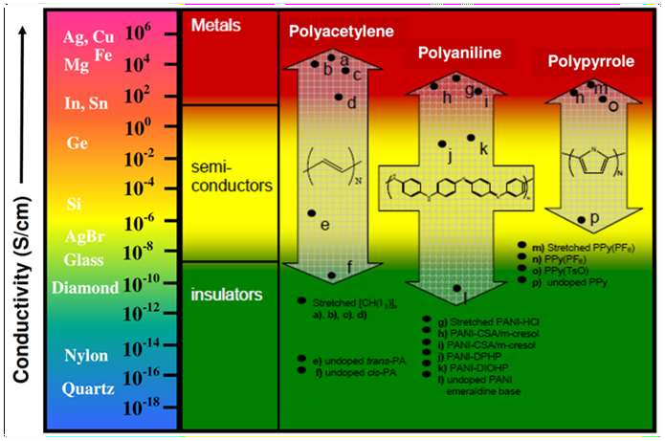
PROPERTIES OF ICP
Electrical conductivity
Ability to store an electric charge
Ability to exchange ions

Slide 11
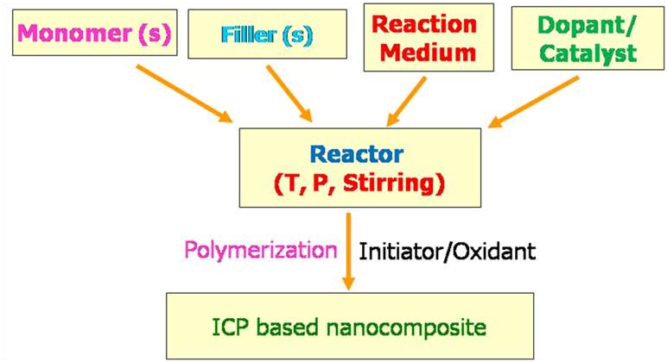
ICP AS A MATRIX POLYMER
It provide design flexibility, good filler incorporation-ability, specific interactions with fillers and microwave non-transparency.

Slide 12
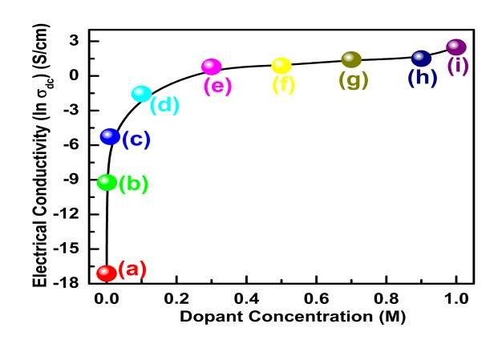
ELECTRICAL PROPERTIES OF ICP BASED NANOCOMPOSITES
Variation of electrical conductivity (ln σdc) of hydrochloric acid (HCl) doped Emeraldine
base (EB) samples as a function of dopant (HCl) concentration (a) 0.0 M (b) 0.001 M, (c) 0.01 M, (d) 0.1
M, (e) 0.3 M, (f) 0.5 M, (g) 0.7 M, (h) 0.9 M and (i) 1.0 M
11

Slide 13
APPLICATION
Fabrication of organic thin film transistors.
Non-volatile memory devices based on organic transistors.
Development of novel conjugated polymers for photovoltaic device applications.
Fabrication of organic photovoltaic cells.
Fabrication of organic light-emitting devices (OLED).
Ferroelectric polymers for thin film devices.
Gene Sensors.
Printed Electronics.
Conducting Polymer Actuators and Micropumps.
Responsive Membranes/Hybrid Plastics.
focusednupon polymer membranes that incorporated electronically conducting polymers and piezoelectric polymers.

Slide 14
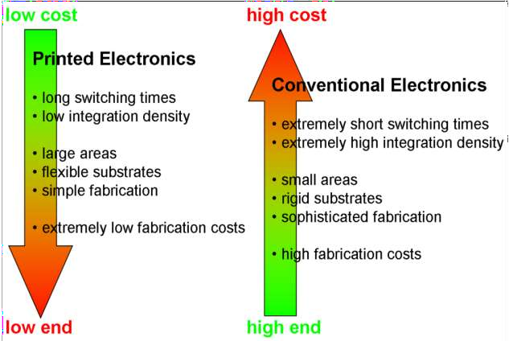
PRINTED ELECTRONICS
It is a set printing create electrical devices on various substract.
Printed electronics, specifies the process and subject to the specific requirements of the printing process selected can utilize any solution-based material.
This includes organic semiconductors, inorganic semiconductors,metallic conductors,nano particles,nano tubes etc.
methods used to
of the printing process selected can
inorganic conductors,
semiconductors, nanoparticles,

Slide 15
PRINTED ELECTRONICS METHODS
Flexo printing: a high pressure method that is especially well applicable to print on plastic substrates
Offset printing: a flat printing technique that makes a high resolution possible
Gravure printing: a low pressure printing method that makes high volumes and the use of organic dissolvent possible
Rotary screen printing: a method that allows to print in thick layers

Slide 16
ORGANIC THIN FILM TRANSISTOR
They use organic molecules rather than silicon for their active material. This active material may be composed of avoide varity of molecules.
ADVANTAGES
Compatibility with plastic substance.
Lower cost deposition process such as spin coating, printing, evaporation.
Lower temperature manufacturing(60-120c).
DISADVANTAGES
Lower mobility and switching speed compared to silicon wafers.

Slide 17
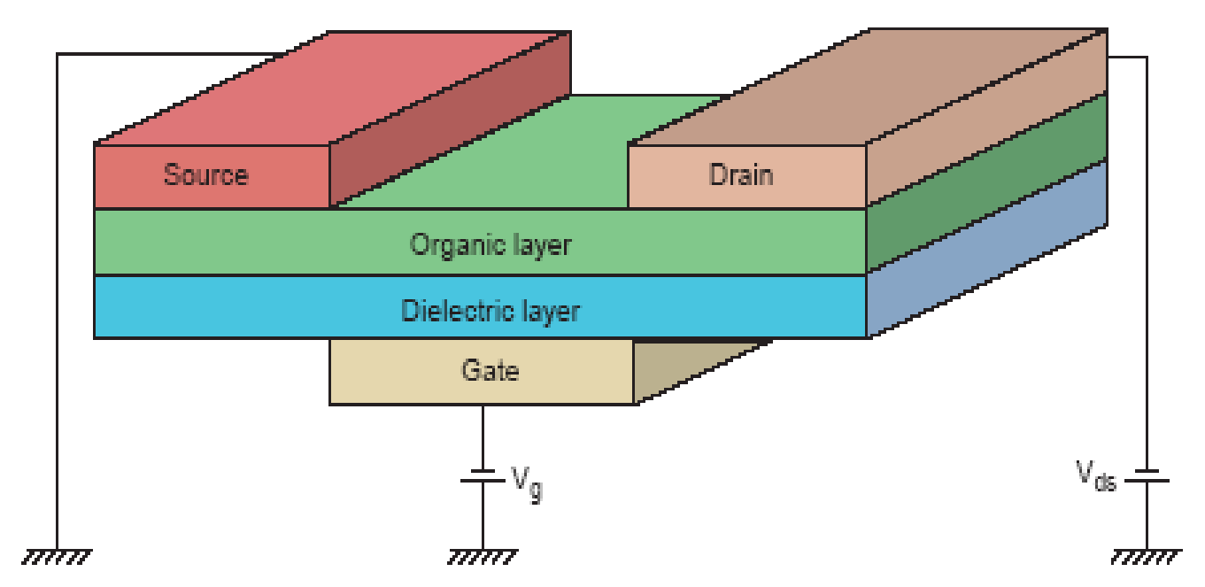
STRUCTURE OF OTFT
Differences
–Carrier Transport
Discrete Energy Levels
Hopping
Depletion Devices
Organic Active Layer
Very Similar to MOSFETs.
3-Terminal Device.
Voltage Controlled Switch.
–Organic Active Layer

Slide 18
APPLICATION OF ORGANIC TFT
OLED Device
OLED Display
Liquid Crystal Device
Plastic TFT LCD
Organic Thin Film
Transistor
E-ink
E-paper, E-book
Antenna
Contactless Smart Card
Materials Integration Technology
Wearable Computer
17

Slide 19
ADVANTAGES V/S DISADVANTAGES OF POLYMER ELECTRONICS
ADVANTAGES
Manufacture is relative simple and inexpensive equipment at low cost.
Light weighted and flexible, very durable under stress and flex can be easily applied over a large surface area.
Freedom of choice of their chemical composition
Adaptable in various ways because of printing methods that can be adjusted to current requirements quickly (printed electronics)
DISADVANTAGES
Due to their intrinsic physical properties (i.e. limited mobility of charge carriers), the performance of polymer electronic products lacks the speed of its silicon counterpart.
Research is still on going to increase performance for more complex functionality.
To be able to improve performance one should be able to distinguish between problems introduced during preparation, intrinsic material properties, and18device characteristics

Slide 20
CONCLUSION
ICPs are Electrically-conductive polymers in which the Conductivity arises from the presence of conjugated car-bon-carbon bonds. These conjugated polymers possess interesting and useful properties due to their delocalised electron systems.
Polymer electronics are light, flexible, and less expensive to produce on a mass quantity scale than conventional electronics
Polymer electronics are not a competing product but are considered to be more complementary to its silicon counterpart.
19

Slide 21
Reference
PC-6: Manual for the Poly-com "6“ Transceiver for 6 meters. Compliments of Larry Saletzki, WA9VRH.
T.Makimoto and T.T.Doi, “Polytronics – Present and future,” in Tech.Dig.Electronics Technologies Meeting,IEDM’02,2002,pp.9-16
Notes:
B-TECH PROJECT MID-SEM PRESENTATION 2011
BY KHUSHBU KHAN & ISAN SAHOO
21

